Slide 1
Chapter 2
Writing for Business Audiences
Ch. 2-<number>

Slide 2
Improving Your Business Writing
The best business writing is
  Audience oriented
  Purposeful
  Economical
To improve your writing skills, you need
  Good teaching materials with excellent model documents
  An effective writing process
  A trainer (like your instructor)
  Practice
Ch. 2-<number>

Slide 3
The Writing Process
Stage 1: Prewriting
Analyzing
Anticipating
Adapting
Stage 2: Writing
Researching
Organizing
Composing
Stage 3: Revising
Revising
Proofreading
Evaluating
Ch. 2-<number>

Slide 4
Factors Determining Channel Selection
Importance of message
Amount and speed of feedback required
Necessity of a permanent record
Cost of the channel
Degree of formality required
Ch. 2-<number>

Slide 5
Factors Determining Channel Selection
Possible Channels:
  E-mail, fax, letter, memo, report, telephone, voice mail, meeting, conversation, Web
    What channel is best to announce decreased insurance benefits for 250 employees?
      E-mail or memo
Ch. 2-<number>

Slide 6
Factors Determining Channel Selection
  What channel is best for a sales message promoting a new product to customers?
    Letter
  What channel is best for responding to similar customer inquiries?
    Web, letter, telephone
Ch. 2-<number>

Slide 7

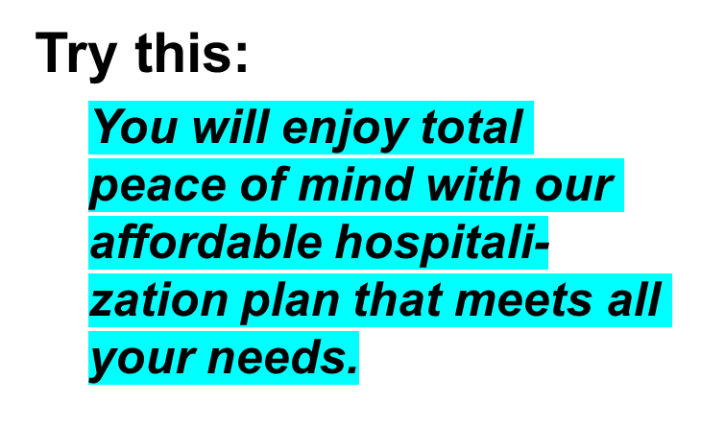
Reader Benefits
Instead of this:
We are promoting a new plan that we believe has many outstanding benefits.
Ch. 2-<number>

Slide 8
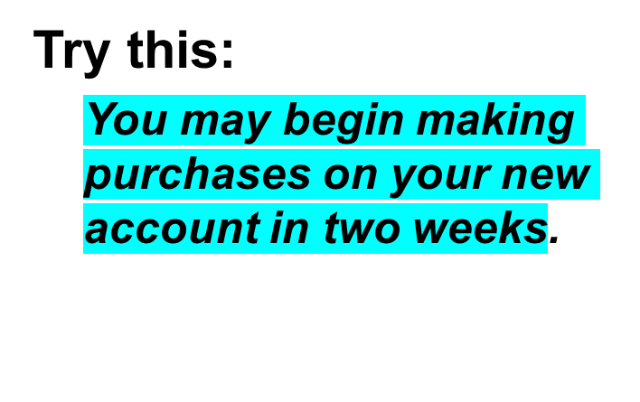
Reader Benefits
Instead of this:
Before we can allow you to purchase items on this new account, we must wait two weeks to verify your credit.
Ch. 2-<number>

Slide 9

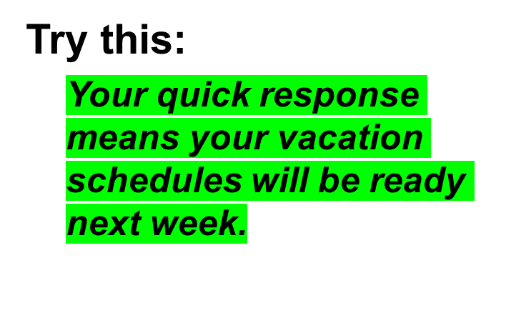
Reader Benefits
Instead of this:
I need your response immediately so that I can make the employee vacation schedule by next week.
Ch. 2-<number>

Slide 10
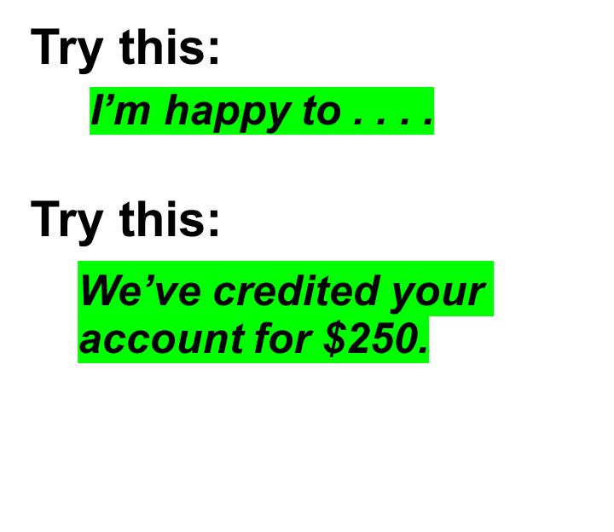
Conversational Language
Instead of this:
The undersigned takes pleasure in . . . .
Instead of this:
It may be of some concern to you to learn that your check has been received and your account has been credited for $250.
Ch. 2-<number>

Slide 11
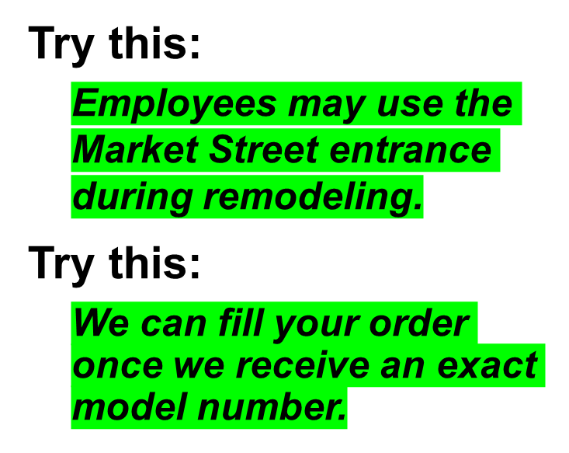
Positive Language
Instead of this:
Employees may not use the First Street entrance during remodeling.
Instead of this:
We cannot fill your order until we receive an exact model number.
Ch. 2-<number>

Slide 12
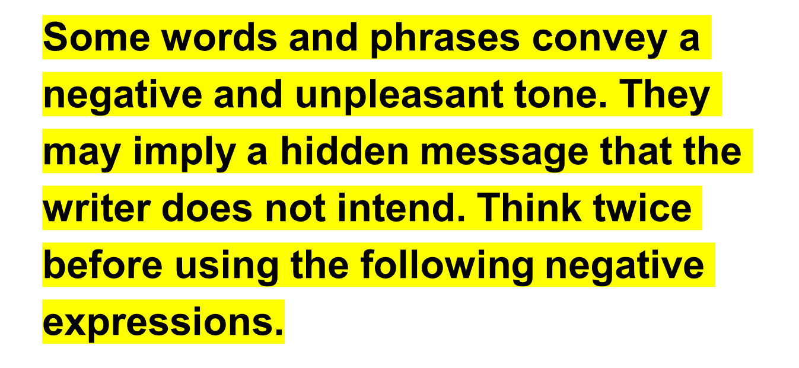
Hidden Messages
Ch. 2-<number>

Slide 13
Hidden Messages
Negative Language:
You overlooked
You state that
You failed to
You claim that
You are wrong
You do not understand
Your delay
You forgot to
Hidden message:
You are careless
But I don’t believe you
You are careless
It’s probably untrue
I am right
You are not very bright
You are at fault
You are inefficient and careless
Ch. 2-<number>

Slide 14
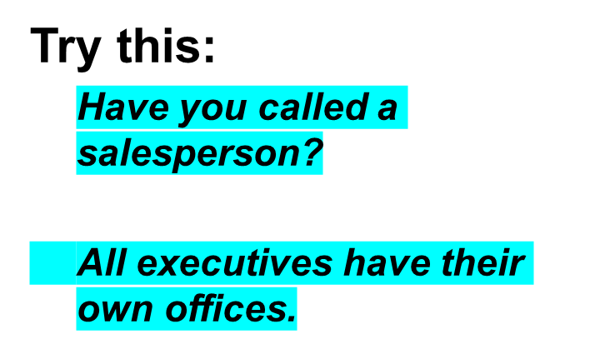
Inclusive Language
Instead of this:
Have you called a salesman?
Every executive has his own office.
Ch. 2-<number>

Slide 15
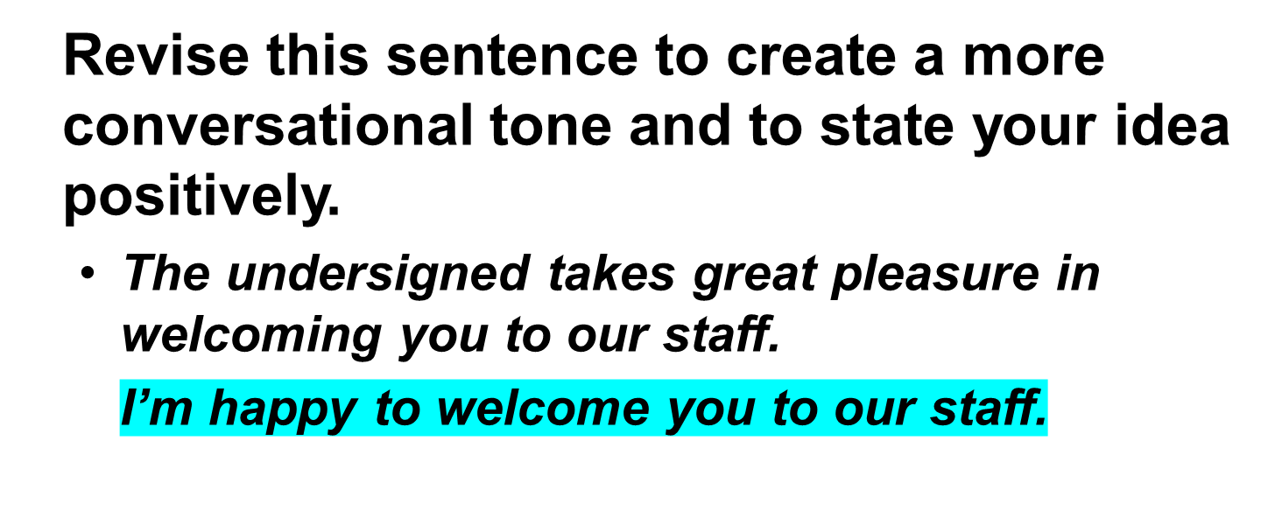
Try Your Skill
Ch. 2-<number>

Slide 16
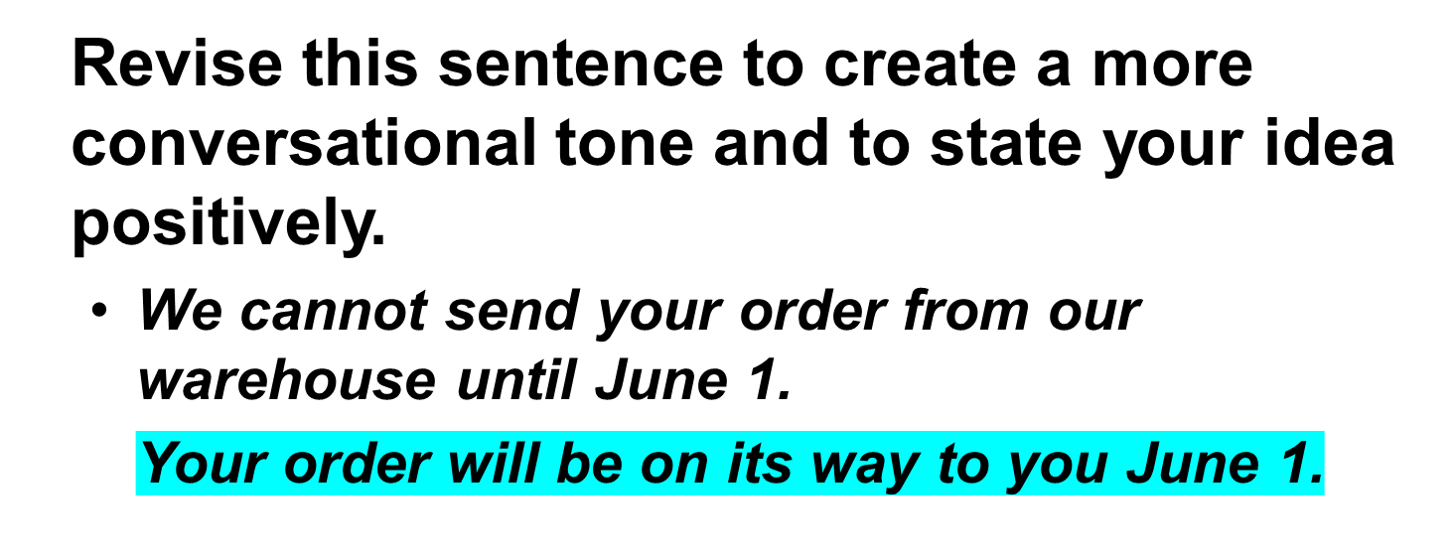
Try Your Skill
Ch. 2-<number>

Slide 17
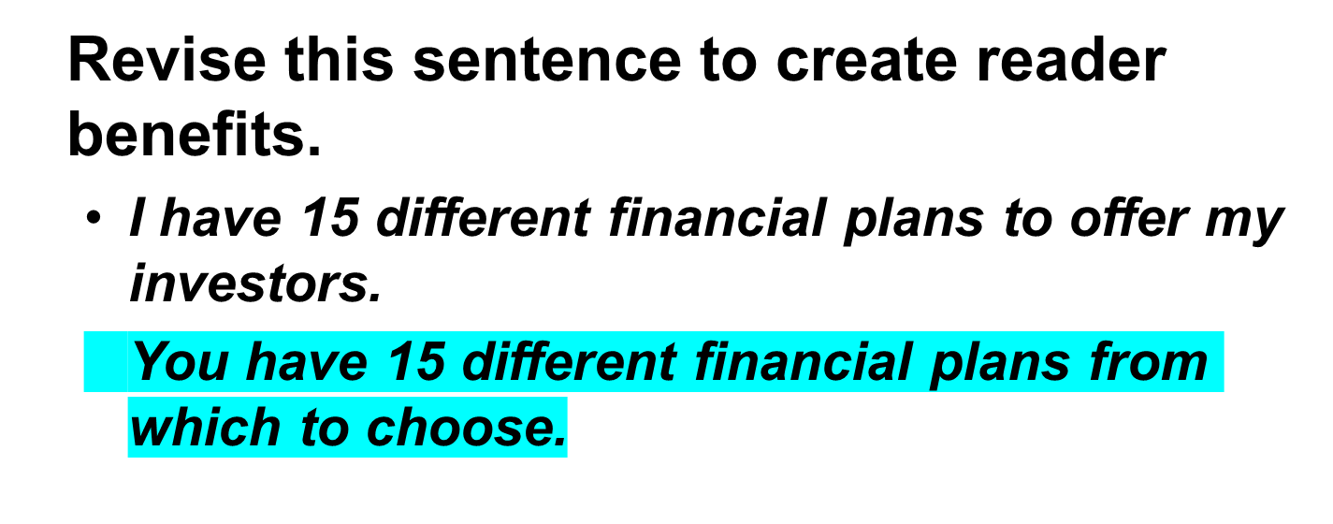
Try Your Skill
Ch. 2-<number>

Slide 18
Try Your Skill
Revise this sentence to create reader benefits.
  We want all newly hired employees to use our carpooling program for at least three months.
  As a newly hired employee, you won’t have to drive to work for the first three months because you can carpool.
Ch. 2-<number>

Slide 19
Plain Language
Avoid federalese, bureaucratese, and inflated language.
Federalese: Each person to whom the request is herein addressed is henceforth solicited to submit, or to have his or her department representative submit, to the Department of Labor official described above, a comment on whether the proposed plan, in his or her considered view, meets the requirements of the 2003 law.
Simple Translation: You may wish to comment on whether the proposed plan meets the requirements of the 2003 law.
Ch. 2-<number>

Slide 20
Familiar Words
Avoid long, difficult, and unfamiliar words. Use short, simple, and common words whenever possible.
Less familiar words:
encounter
extrapolate
obligatory
terminate
Simple alternatives:
meet
project
required
end
Ch. 2-<number>

Slide 21
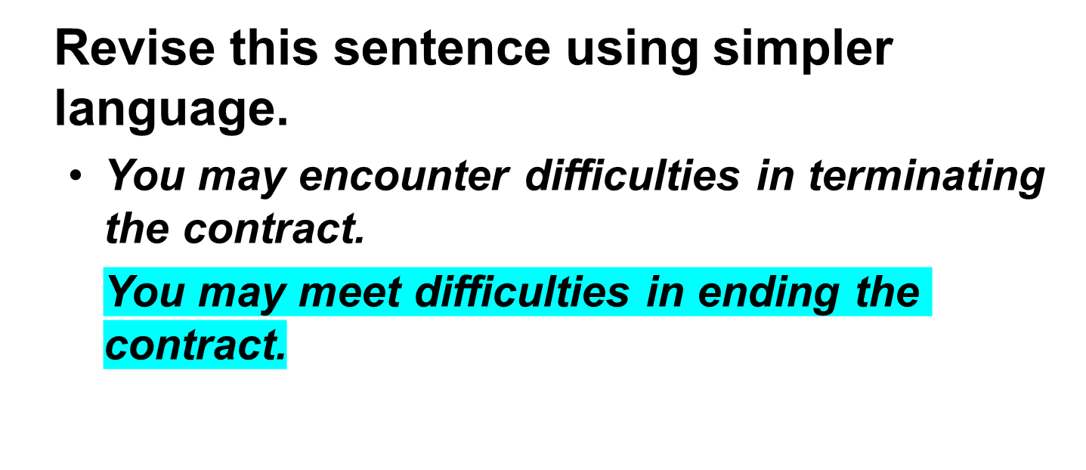
Try Your Skill
Ch. 2-<number>

Slide 22
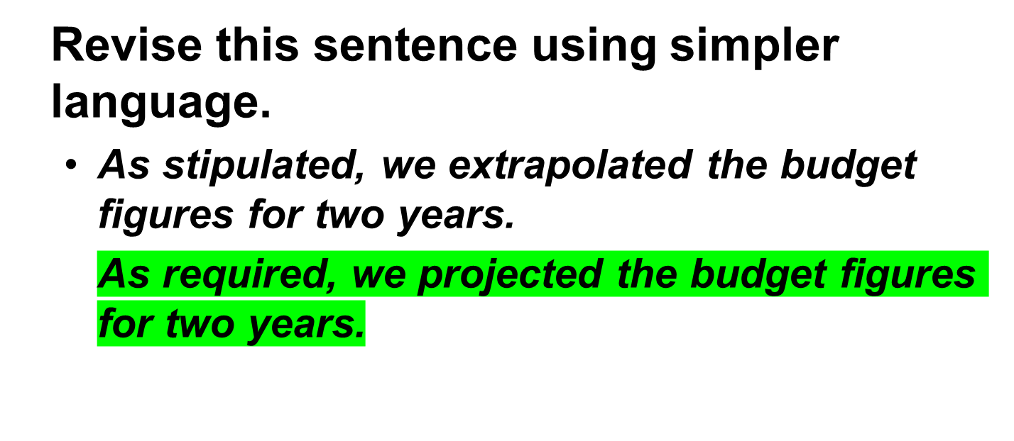
Try Your Skill
Ch. 2-<number>

Slide 23
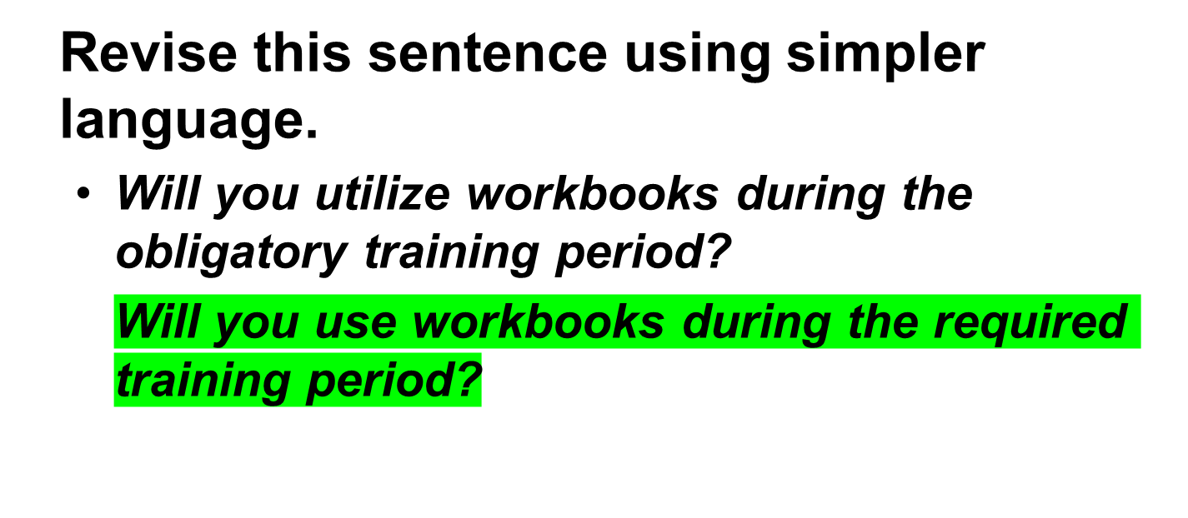
Try Your Skill
Ch. 2-<number>

Slide 24
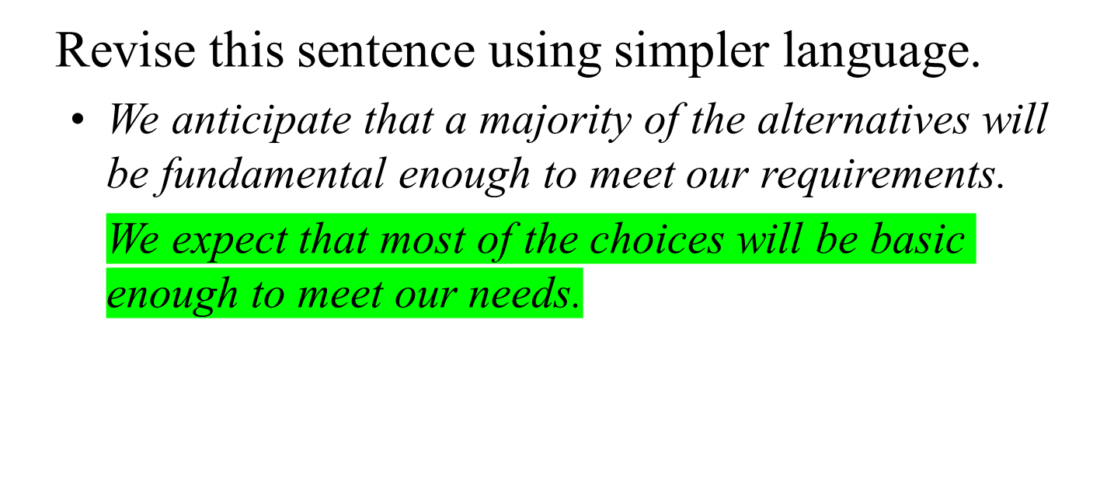
Try Your Skill
Ch. 2-<number>

Slide 25
Seven Ways Technology Can Improve Your Business Writing
Fighting writer’s block
Collecting information electronically
Outlining and organizing ideas
Improving correctness and precision
Adding graphics for emphasis
Designing and producing professional-looking documents, presentations, and Web pages
Using collaborative software for team writing
Ch. 2-<number>

Slide 26

Increasingly, businesses need to ensure that they are not only connected with the employees and customers, but also that their employees are connected with one another.
Form groups of three or four individuals. Discuss why connection is essential and draw up a list of points. Discuss and list the advantages and disadvantages of constant connectivity. Then share your points with the rest of the class.
Ch. 2-<number>

